Slide 1
Design and Architecture of a bond electronic Trading Platform

Slide 2
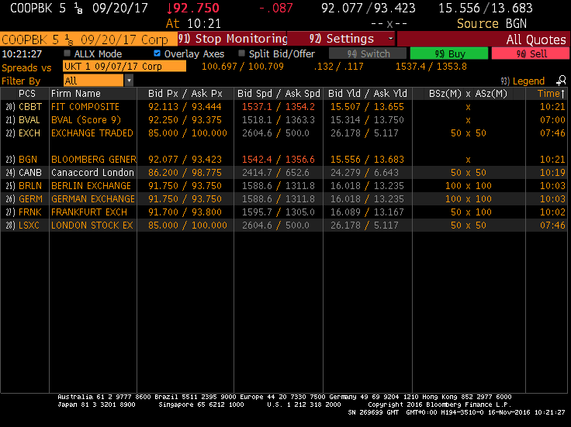
background
Trading Venues (ECN, Voice, etc)
Request For Quote (RFQ)
Bond Pricing
Trade Execution
Deal booking
Sample Bloomberg Terminal

Slide 3
Traditional architecture
Trade Execution Engine
ECN 1
Subscriber
Reference Data
RFQ/Orders
FIX Message
Relational
Database
Transformer
Booking
Read/Write
ECN 2
RFQ/Orders
FIX Message
State Machine
Pricing
Publisher
Trading Control
……
Reference Data
Risk/Position
Price Message
Deal Message
Enterprise Message Bus

Slide 4
challenges
Scalability
Fault Tolerance
Performance
Time to market

Slide 5





Microservices architecture
Elastic search / Logstash / Kibana
Envoy Service Mesh
Apache Kafka
Redis Disstributed Cache Cluster
ECN 1
Transformer
Transformer
Message
Journal
Session
State
Transform Service
TradingControl
gRPC Stream
RFQ/Orders
ProtoBuff
DB
ECN 2
FIX Message
ECN GW 1
gRPC Stream
Pricing Service
Gateway
ExceptionHandler
ProtoBuff
gRPC Stream
ProtoBuff
Execution Service
Booking Service
……
Reference Data
Risk/Position
Price Message
Deal Message
Enterprise Message Bus

Slide 6




Deployment strategy
Spring Boot/Maven packaging
Jenkins/Ansible playbook for deployment
Apache Mesos/Marathon for service management

Slide 7
Microservices Benefits
RFQ hit ratio was increased by 20%
Application release cycle was reduced from 2 week to a few day
Component reusability has been increased. Common services like Reference Data, Trading Control, Exception Handler are spinning up from the same code base
No more performance bottleneck on Database IOs

Slide 8



future Improvements
Containerization using Docker
Service monitoring using Prometheus/Grafana

Slide 9
Q & A

